Slide 1


By Halcyon Hacks
Legal Advice Accessible for All

Slide 2
PROBLEM STATEMENT
Justice is elusive as the law may be daunting, complex and far from inclusive. Current resources to find legal advice are excessive, rigged and uneconomical.

Slide 3
Competitive Landscape
 | Singapore Legal Advice | Asia Law Network | Priori Legal
Key Features | Lawyer database Quick consult service | Lawyer database Quick consult service | Boutique firm network Process management service Payment transparency
Target Demography | General | SMEs, Startups | SMEs and MNCs
Revenue Model | Advertising (?) | Freemium Model | Commission

Slide 4
PRODUCT OVERVIEW
LegalEyes is a SaaS product for the lay person who has little engagement with the law:
NLP analysis for identifying necessary legal support
Matching algorithm providing range of lawyers across possible price points
Quick access to legal aid across different areas of law
A marketplace for lawyers from all practices:
Matching system averts advertising monopolies
Review system which focuses on client feedback, not just prior experience, qualifications and achievements

Slide 5

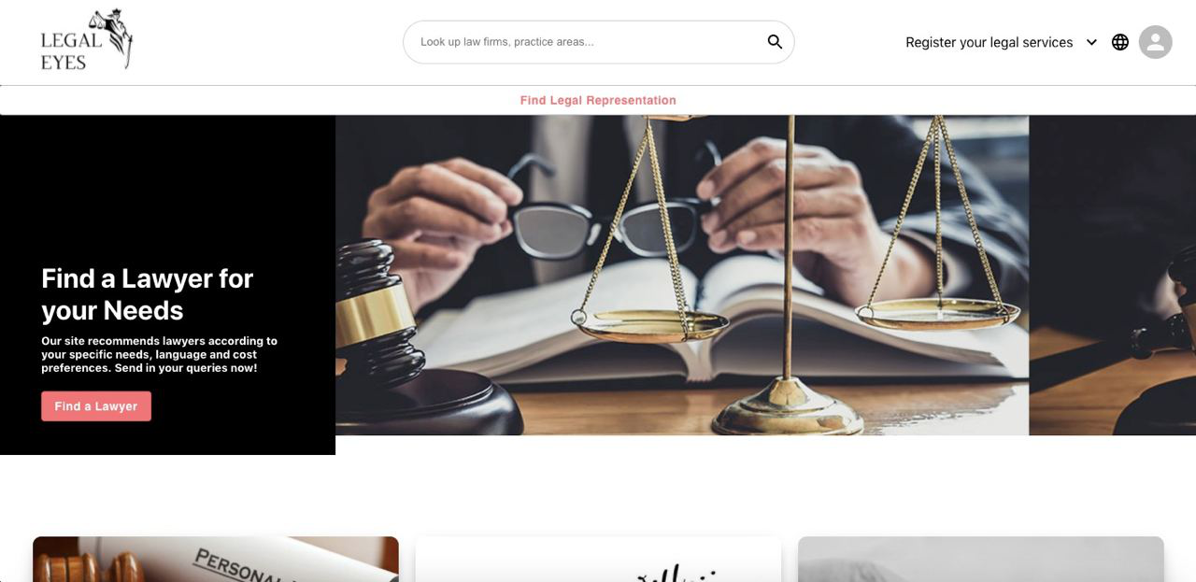
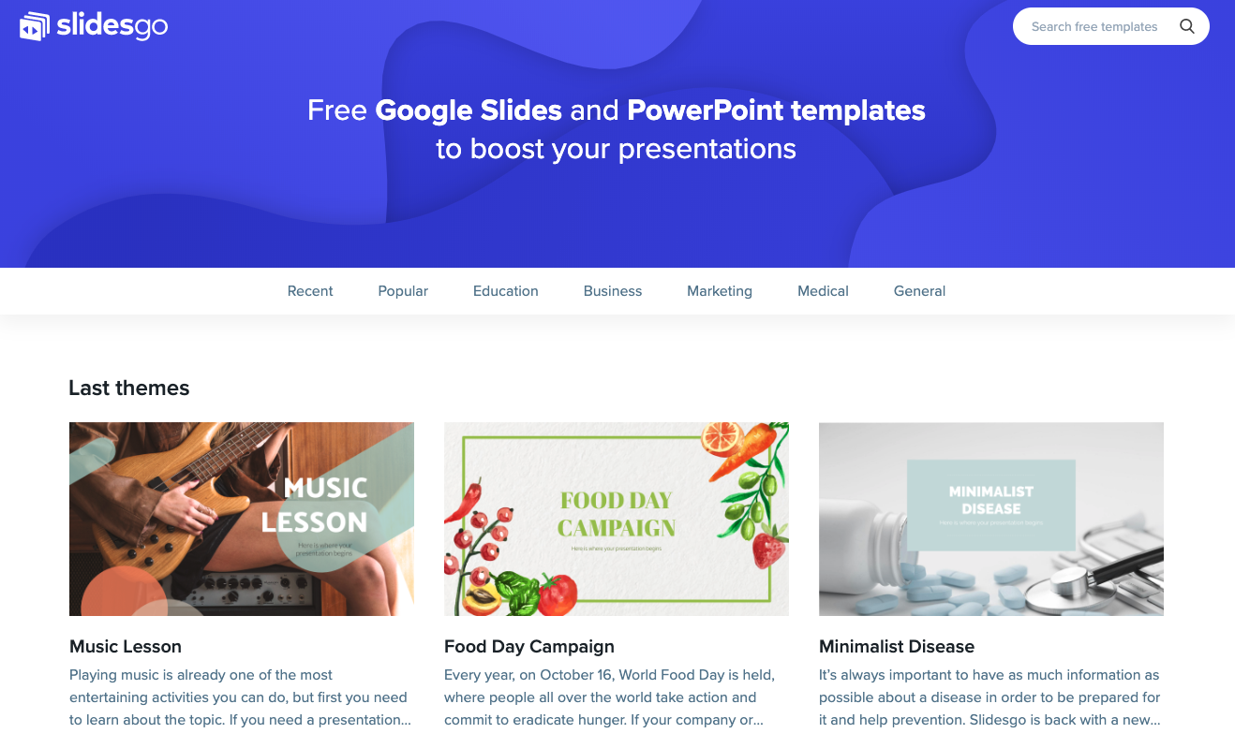
PROTOTYPE
This is what our landing page looks like. Let’s try the sorting and matching algorithm. It was trained on >900 legal queries.

Slide 6
BUSINESS MODEL & POTENTIAL
PHASE 1: Customer Acquisition and Training
PHASE 2: Expanding across Value-Chain
Premium features (e.g. increasing number of tags for practice areas, higher view rate in algorithm, ability to send more queries)
Flat matching fee borne by lawyer
Platform Management Fees; Transaction/Escrow Fees
Enterprise account fees
Premium functions (e.g. process management, smart contracts, etc.)

Slide 7
OUR IMPACT
MINIMAL HASSLE
PRICE EFFECTIVE
RAPID SUPPORT
The process of “shopping” for lawyers is simplified
Users can find legal advice and representation according to their budget
Receive legal aid for acute issues within 48 hours

Slide 8












TEAM HALCYON HACKS
Vasu Namdeo
Genessa Chew
Wang Xing Hao
Wu Jiankai
Benjamin Peck

Slide 9
THANK YOU
Feel free to reach us at e0435545@u.nus.edu.sg

Slide 10
01
02
03
AUTOMATION CAPABILITIES
DEMAND FOR LEGAL AID
GROWING POOL OF LAWYERS
ANNEX 1: KEY MARKET TRENDS
The legal industry must automate to accommodate clients better
Disproportionate CoVID-19 effects on SMEs and employees (e.g. bankruptcy, employment, contractual disputes)
Challenging economic environment and growing supply of lawyers drives demand for new ways to acquire clients

Slide 11
ANNEX 2: COMPETITIVE POSITIONING
MNCs
Priori Law
Single-function
(Matching)
Asia Law Network
End-to-end
Singapore Legal Advice
Individuals

Slide 12
ANNEX 3: CLIENT’S JOURNEY
Problem
Matching
Client details problem; NLP algorithm identifies legal issues and possible areas of law
Selected lawyer accepts query and legal aid is rendered via platform
Onboarding
Resolution
Client is looking for legal advice/representation; unfamiliar with areas of law
Algorithm recommends relevant lawyers ranked; Client selects which lawyers to send query to

Slide 13
ANNEX 4: LAWYER’S JOURNEY
Application
Matching
Due diligence and verification of qualifications performed
If selected by client, lawyer can view client’s problem and decide whether to accept
Verification
Resolution
Lawyer applies; states up to 5 areas of practice, experience, qualifications
Once approved, lawyer will be potentially recommended

